Slide 1

SANDY HOOK COMMUNITY ASSOCIATION ANNUAL GENERAL MEETING
Notes:
Welcome to the 2025 Sandy Hook Community Association AGM
Thank you for coming, please sign up for next year and pay your dues.
Please add any suggestions for your SHCA on to sticky notes and post on the board
Explanation of dues (KEN) – when updating our Bylaws we noticed that by having $20 per household this would create a scenario where singles could charged more for their vote, so we have amended it to $10 per voting member.

Slide 2
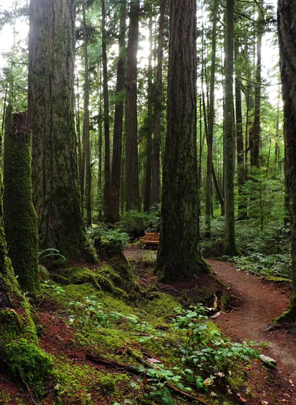
Land Acknowledgment
This meeting is located on the traditional unceded territory of the Shishalh nation
Notes:
- To me a land acknowledgement should be personal and connected to more than words. When I walk the beautiful area of Sandy Hook, or even Hidden Grove, I feel a deep connection to the forest, waters and lands on the sunshine coast and I want to acknowledge and thank the Shishalh nations who have taken care of this land for generations.

Slide 3
Agenda
Meet & greet and member sign up
Presentation by community forests
  Wildfire Risk Reduction Initiative with our special guests Sara Zeileman and WarrenHassen
Agm call to order
    Introduction / appointment of chair
    Confirmation of quorum
    Approval of agenda
    Approval of 2024 minutes
    Presidents report
    Treasurers report
    Election of directors
    Door prizes
    adjournment
Notes:
- Review of agenda and introduction of Community Forests for their presentation

Slide 4


Sunshine Coast Community Forest Presentation

Slide 5
2025 Board of Directors
President – Ken Hookham
Vice President – Dale Komanchuk
Secretary – Manon Gelinas
Treasurer – May Jim
Board Members – Jane Allan, Jennifer Garden, Karen Taylor, Randy Knill
AGM Chair – Manon Gelinas

Slide 6
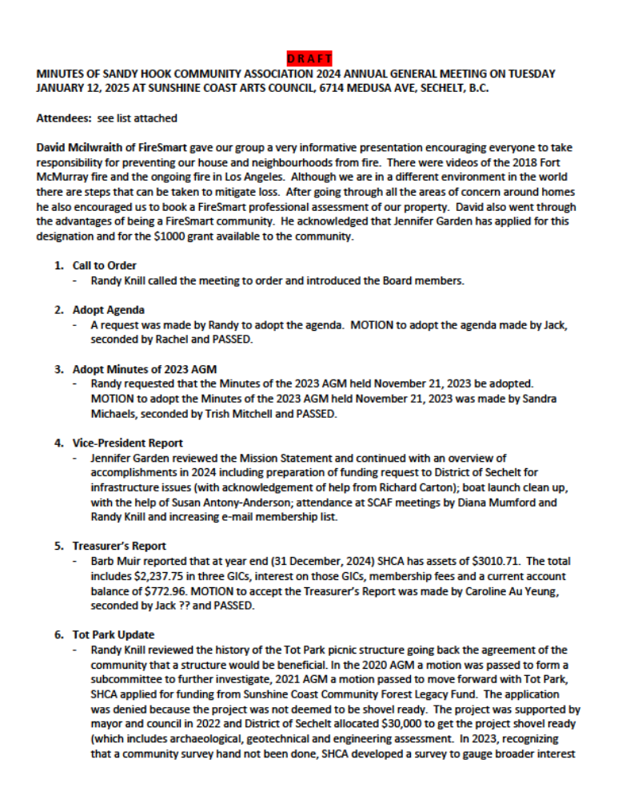
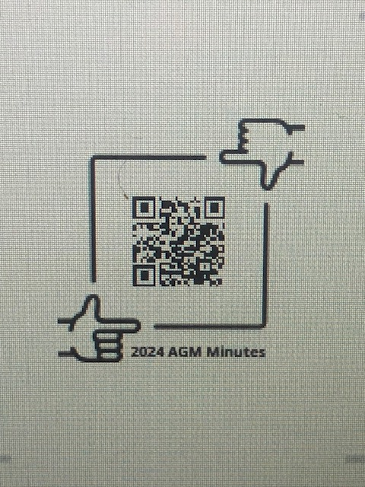
Approval of 2024 Minutes

Slide 7
Presidents Report
SHCA Mission statement
The Sandy Hook Community Association’s (SHCA) mandate is to unite residents and members, and build community relationships.
SHCA is unbiased and acts in the best interests of residents and members alike through subcommittee meetings and groups.
Working on behalf of residents and members, the SHCA sources and collates information required for eventual decision making and action.

Slide 8
Presidents Report
SHCA Purpose
Promote and maintain standards for environment and community.
Plan programs and build community facilities.
Raise funds and seek grants.
Cooperate with other organizations.

Slide 9
Presidents Report
SHCA Core Activities
Host monthly Board meetings.
Attend monthly SCAF meetings.
Communicate with DOS (e.g. annual budget requests, issues/actions, variance requests).
Attend DOS public consultation and provide feedback.
Communications with members and residents (e.g. website, emails, Facebook).
Membership, AGM, Financials.

Slide 10
Year in Review
DOS Road Safety Meeting
Spring BBQ
Fire Smart Chip Up
Sandy Hook Sign Painting & Touch Up
SHCA Letter to SCAF on DOS Community Plan
Updated Registration List & Website
DOS Annual Budget Requests
Road Line & Barrier Painting
Updated Bylaws
FireSmart Status 2026
SHCA Letter to SCAF on DOS Community Plan
DOS Annual Budget Requests
Updated Bylaws
Q4
Q3
Q2
Q1
DOS Road Safety Meeting
Spring BBQ
Fire Smart Chip Up
Sandy Hook Sign Painting & Touch Up
Updated Registration List & Website
Road Line & Barrier Painting
FireSmart Status 2026
Notes:
SCAF Update – Poster signs it delays from DOS. Still ongoing. SCAF continues to work with DOS to get more involvement in the community plan for areas outside of DT. Diane Mumford has done great work creating emergency preparedness kits while working with SCAF, and these are available for purchase for those who wish.

Slide 11

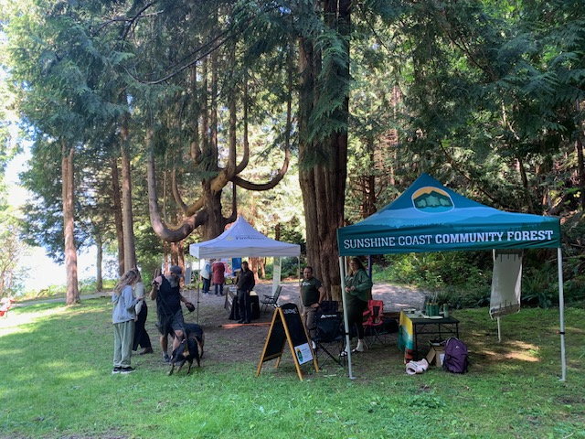
Spring BBQ & FireSmart Chip Up Event

Slide 12
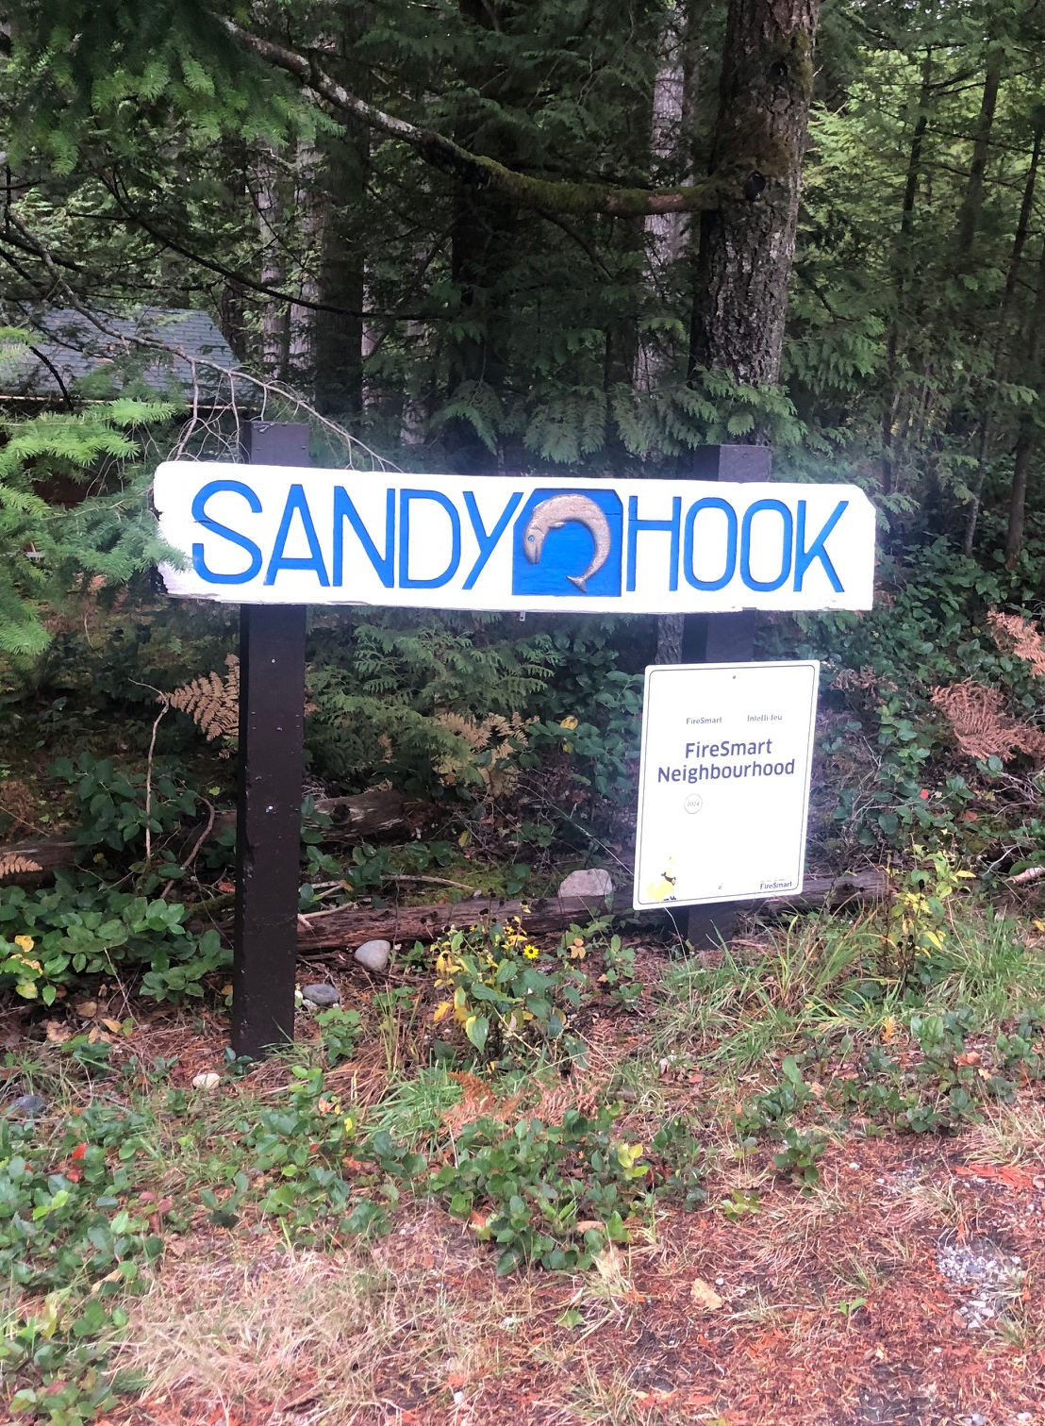
Road Safety Meeting
&
Sign Painting
SHCA AGM 2025
Notes:
- To me a land acknowledgement should be personal and connected to more than words. When I walk the beautiful area of Sandy Hook, or even Hidden Grove, I feel a deep connection to the forest, waters and lands on the sunshine coast and I want to acknowledge and thank the Shishalh nations who have taken care of this land for generations.

Slide 13
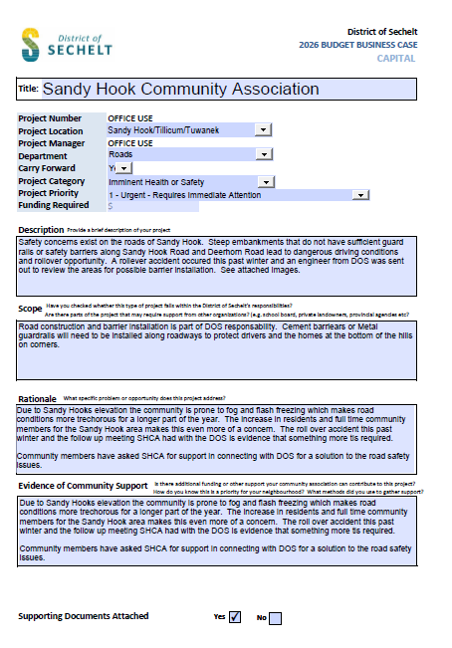
DOS Budget Requests
Road Safety Concerns
  – crumbling road in lower sandy hook
Road Safety Concerns
  – line painting, barriers, reflectors
Tot Park Renovation
  - DOS to review drainage, and look to replace playground

Slide 14
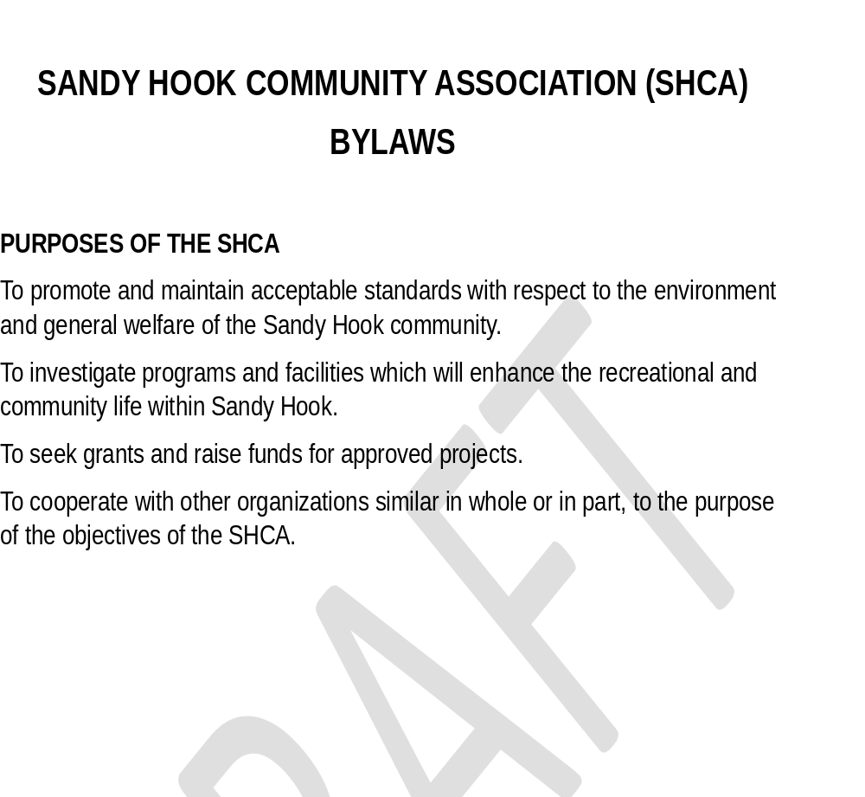
Updating Bylaws
Bylaws will be available on SHCA website, or by request
Will vote in January to approve bylaws
Notes:
Jane to speak about Bylaws

Slide 15
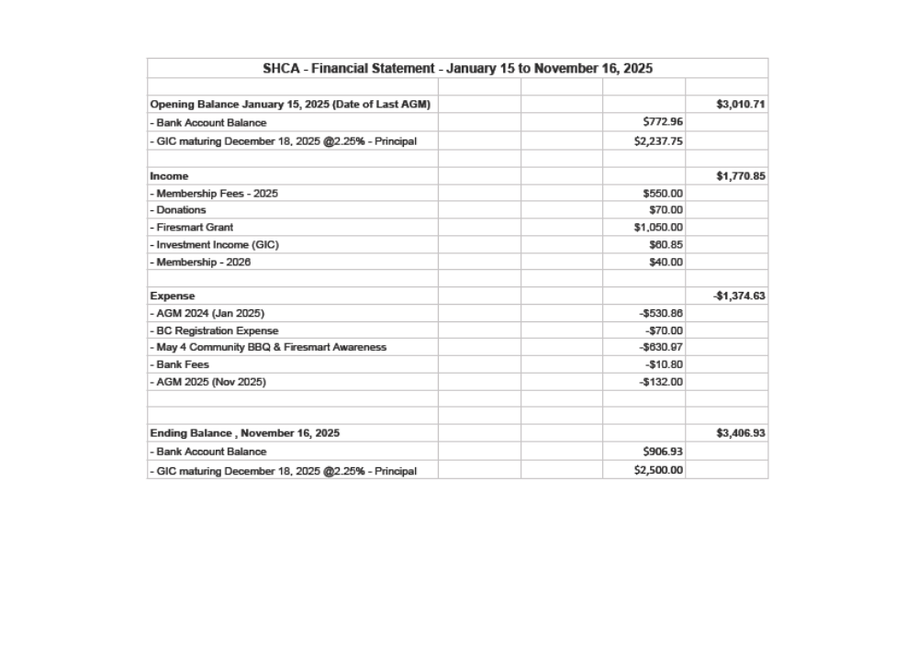

Slide 16
Election of Directors
President
Vice President
Treasurer
Secretary
General Board Member(s)

Slide 17
Door Prizes!!!

Slide 18
Adjournment &
Thank you
SHCA Association board 2025

